Slide 1
Mini Project 3
House Price Classification Modelling Report
Max Kim

Slide 2
Objectives
Multiple different factors influencing house price and it is difficult to estimate house price with just few features
Indicate house buyers to know the price range of their dream house
Provide property investors to understand the trend of housing prices
Help developers to determine the selling price range of a house

Slide 3
Dataset
Data source from Kaggle
https://www.kaggle.com/competitions/house-prices-advanced-regression-techniques/overview
Containing various features with house prices stated
Size & Volume
The dataset contains 1460 records of house prices with 79 features
Data Dictionaries examples
GrLivArea: Above grade (ground) living area square feet
LotArea: Lot size in square feet
SalePrice - the property's sale price in dollars. This is the target variable that you're trying to predict.
OverallQual: Overall material and finish quality
GarageArea: Size of garage in square feet
Fence: Fence quality
Kitchen: Number of kitchens

Slide 4
Target Variable
Target Variable: Sale Price
Our target variable is stated as exact amount of the sales price. Divide these prices into 4 different categories (based on quantile) to predict range of prices that a house will fall into.
Category | Range
0 | <=110K
1 | Between 110K - 163K
2 | Between 163K - 214K
3 | >214K

Slide 5
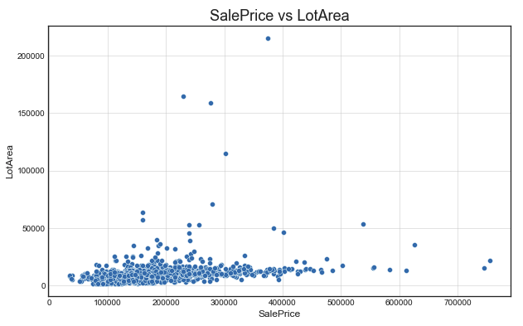
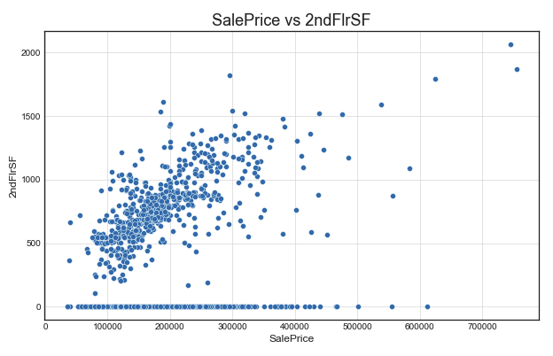
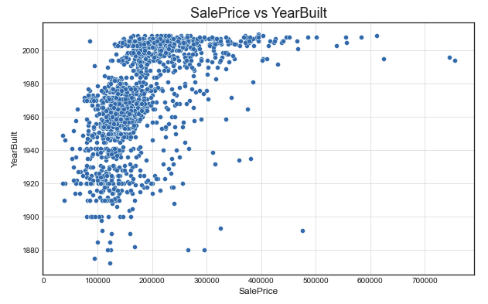
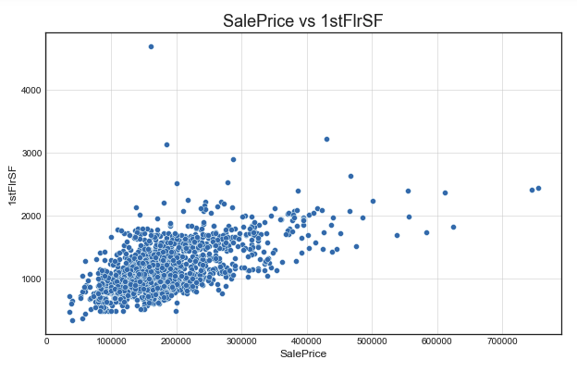
Relationship

Slide 6
Base Modelling
Model | Accuracy | ROC AUC | Precision | Recall | F1-Score
Logistic Regression | 0.67 | 0.88 | 0.67 | 0.67 | 0.67
KNN | 0.66 | 0.85 | 0.67 | 0.66 | 0.67
SVC | 0.53 | 0.81 | 0.39 | 0.53 | 0.42
Decision Tree | 0.75 | 0.89 | 0.75 | 0.75 | 0.75
Random Forest | 0.78 | 0.94 | 0.78 | 0.78 | 0.78
Logistic Regression: High area under the curve but poor score in class 0 & 2 with overall not a good model score
KNN: Similar to Logistic Regression model with poor score in class 2
SVC: Low overall accuracy with 0 precision and recall for class 0
Decision Tree: High accuracy and area under the curve. Overall balanced values across all classes for precision and recall
Random Forest: Highest accuracy with area under curve. Overall better score for precision and recall for all classes than decision tree

Slide 7
Bagging & Boosting
Attempt bagging and boosting technique to improve on our models.
Bagging Model | Accuracy | ROC AUC | Precision | Recall | F1-Score
Logistic Regression | 0.68 | 0.88 | 0.68 | 0.68 | 0.68
vs Base | +0.01 | - | +0.01 | +0.01 | +0.01
KNN | 0.66 | 0.86 | 0.67 | 0.66 | 0.66
vs Base | - | +0.01 | - | - | -0.02
SVC | 0.53 | 0.82 | 0.52 | 0.52 | 0.52
vs Base | - | +0.01 | +0.13 | - | +0.10
Decision Tree | 0.74 | 0.93 | 0.74 | 0.74 | 0.74
vs Base | - | +0.06 | - | - | +0.01
Random Forest | 0.79 | 0.94 | 0.79 | 0.79 | 0.79
vs Base | +0.01 | - | - | +0.01 | +0.01

Slide 8
Bagging & Boosting
AdaBoosting Model | Accuracy | ROC AUC | Precision | Recall | F1-Score
Logistic Regression | 0.66 | 0.83 | 0.65 | 0.66 | 0.65
vs Base | -0.01 | -0.05 | -0.02 | -0.01 | -0.02
SVC | 0.47 | 0.81 | 0.49 | 0.47 | 0.39
vs Base | -0.06 | - | +0.10 | -0.06 | -0.03
Decision Tree | 0.74 | 0.91 | 0.76 | 0.74 | 0.74
vs Base | - | +0.04 | +0.02 | - | +0.01
Random Forest | 0.77 | 0.94 | 0.77 | 0.77 | 0.77
vs Base | -0.01 | - | -0.02 | -0.01 | -0.01
No boosting for KNN since it did not have the attributes for supporting sample weighting

Slide 9
Modelling Summary
Overall, random forest had highest performance out of these models. Boosting method mostly decreased the performance
From the summary, we can observe random forest with bagging achieved the highest results but has very small improvement on accuracy comparing to the base model (+0.1%)

Slide 10
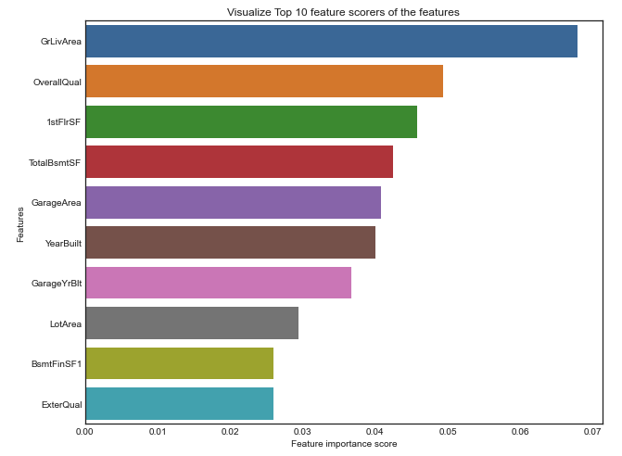
Feature Importance
Using Random Forest to see what are the important features to consider when deciding the price range of the house

Slide 11
Conclusion
Train multiple classification models with number of different features of houses
Observed that the feature that strongly correlated with house price is the living area size and overall material quality
Best base model performance was from random forest. There were slight improvement on the accuracy for this model from bagging, however, there was no significant improvement.
Potentially further optimized through parameter adjustment as there are still room for improvement since highest performance at the moment is 0.79 accuracy rate
As time pass, the trend and feature importance can be change. In order to be a practical use, we need to input latest sales price and features.

